Slide 1




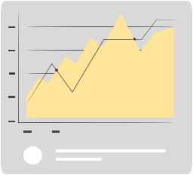
META STOCK PRICE Time Series Analysis
Apoorv Vaishampayan

Slide 2
Table of contents
1
3
2
4
Introduction
Meta Stock Price analysis
Results Analysis
Model Diagnostics, Residual Analysis, Time Series Forecasting(Predictions)
Data Preparation
Data source, Exploratory analysis, Transformations
Conclusions

Slide 3

1
Introduction

Slide 4

Introduction
Meta Platforms Inc. Stock Price Dataset
Weekly dataset (3rd week of May 2012 – 2nd week of March 2024).
Stock prices have been increasing over the past few decades since going public on May 18, 2012
Examine historical trends, temporary and permanent seasonality, and predict future months
Understand the key drivers & events that impacted Meta Stock Price

Slide 5

Background
Stock prices continue to fluctuate depending on the market conditions
Meta stock journey reflects market and innovation.
From IPO lows to record-breaking highs.
Recovery and resilience marked Meta’s trajectory
Analyze the data
Data diagnostics
Model Selection and comparison
Predict future prices

Slide 6
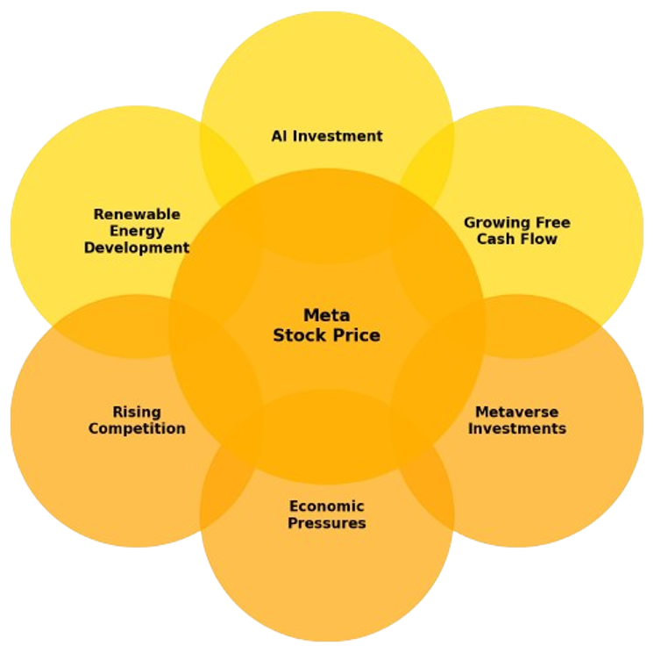
Key Drivers & Key Challenges

Slide 7
Key Drivers for Meta Stock Prices
Key Drivers for Meta Stock Price
AI Investments - Meta is driving growth with $37B+ in Ray-Ban Meta AI glasses and more.
Renewable Energy Development - Meta is committed to 100% renewable energy and achieving net zero emissions by 2030.
Growing Free Cash Flow - Meta’s free cash flow has doubled since 2019, reaching a record $43B.

Slide 8
Key Challenges that impact Meta Stock Prices
Challenges/Events that Impacted Meta Stock Prices
Rising Competitions - Growing competition from TikTok, and YouTube impacts user engagement.
Economic Pressures - Global economic slowdowns and ad market challenges weigh on Meta's revenue.
Metaverse Investments - Heavy spending on metaverse projects raises concerns about profitability.

Slide 9
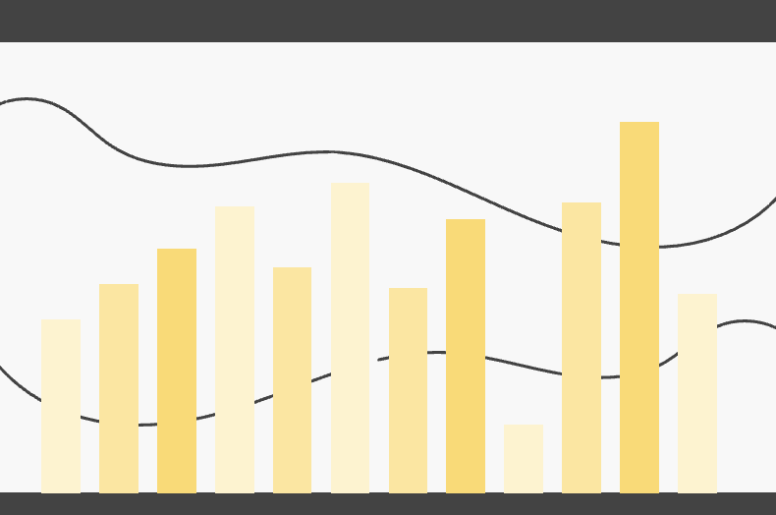
2
Data Preparation

Slide 10
Summary Statistics
Metric | Opening Price | Highest Price | Lowest Price | Closing Price | Trading Volume (Millions)
Total Records | 618 | 618 | 618 | 618 | 618
Average | 161.72 | 167.27 | 156.8 | 162.4 | 119.64
Standard Deviation | 97.26 | 100.27 | 94.54 | 97.6 | 93.03
Minimum | 18.07 | 19.43 | 17.55 | 18.06 | 6.94
25th Percentile | 80.61 | 83.01 | 79.36 | 81.52 | 59.74
Median (50%) | 156.75 | 164.08 | 150.67 | 157.26 | 90.13
75th Percentile | 207.82 | 216.42 | 202.31 | 210.18 | 142.99
Maximum | 503 | 523.57 | 487.89 | 505.94 | 610.88

Slide 11
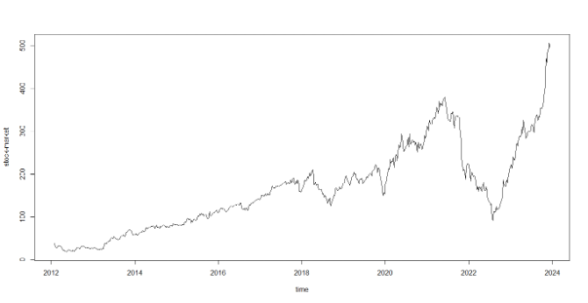
Preliminary plots
The plot of the raw data indicates non-constant variance and an upward trend
ADF test: p = . 8012

Slide 12
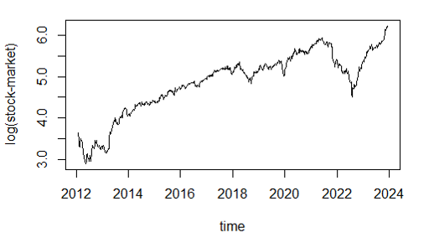
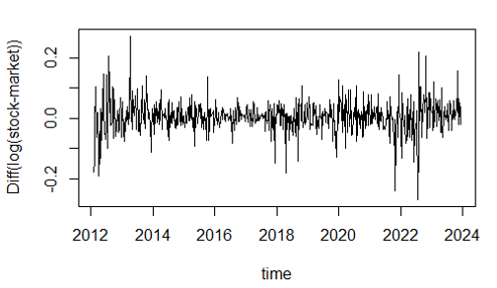
Adjusting for Stationarity
The plot of the log transformed data indicates non-constant variance and an upward trend
ADF test: p = . 5109
The plot of the difference of the log data indicates constant variance and mean
ADF test: p = . 01
We adjusted for data after taking the log of the data using (logx) and difference (dlogx) of the data using diff(logx),
ADF test: p < .01

Slide 13
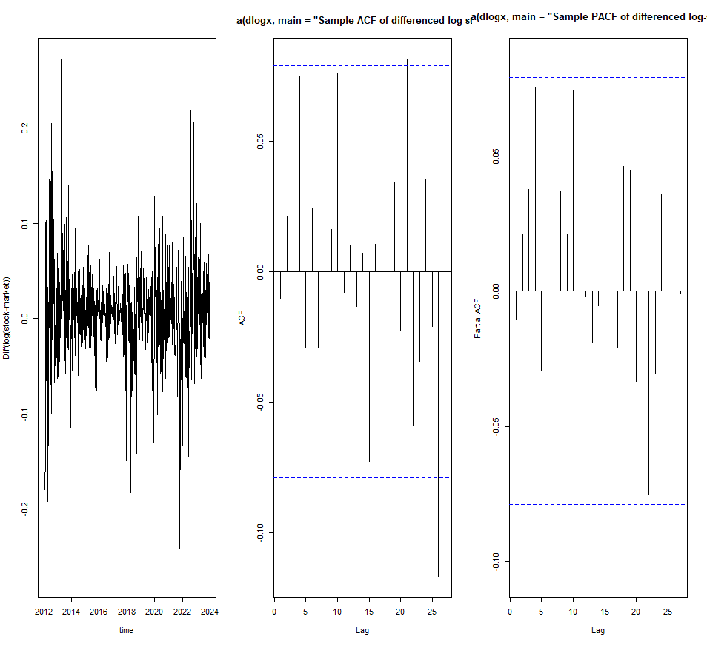
Initial Model Diagnostics
This is the ACF and PACF along with the Stationary Time Series Plot of the Differenced Logarithmic Series which is used to begin the Model Analysis further.

Slide 14
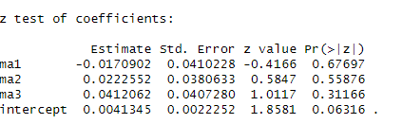
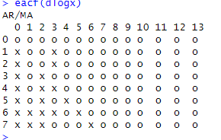
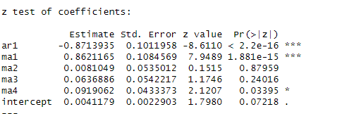
Model Selection
Model : MA(3)
Model : ARMA(1,4)
We have selected the model based on the EACF(dlogx) and selected Models: MA(3) and ARMA(1,4)

Slide 15
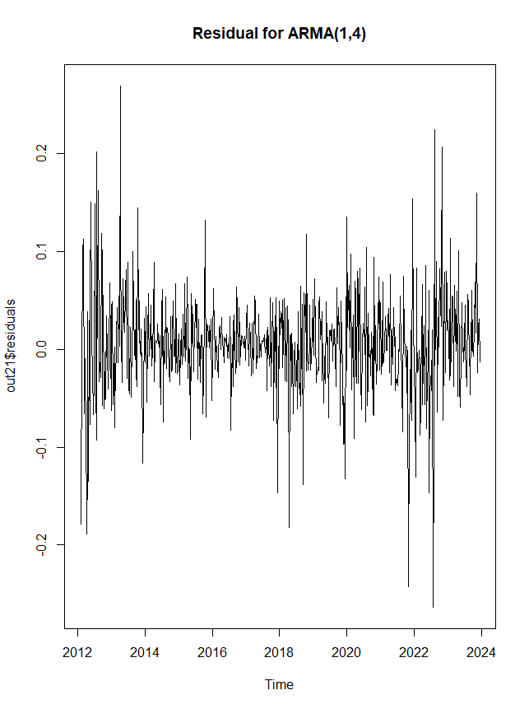
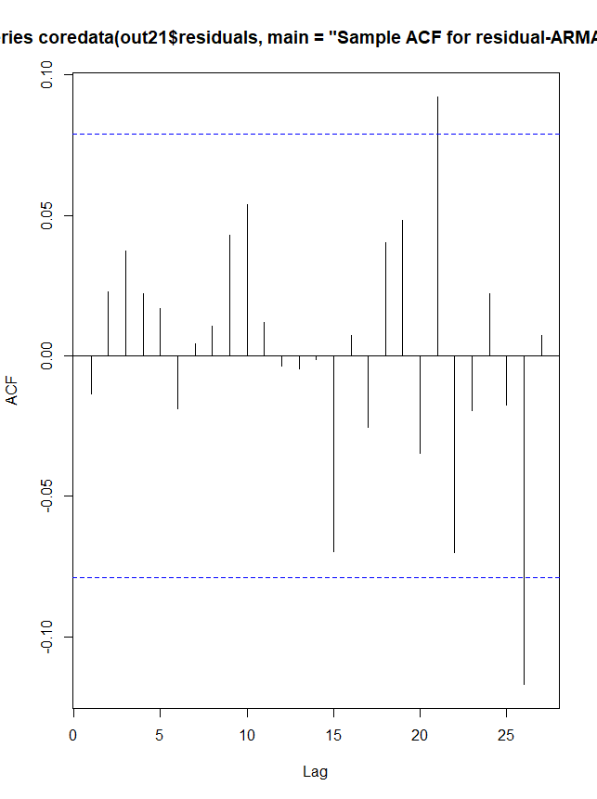
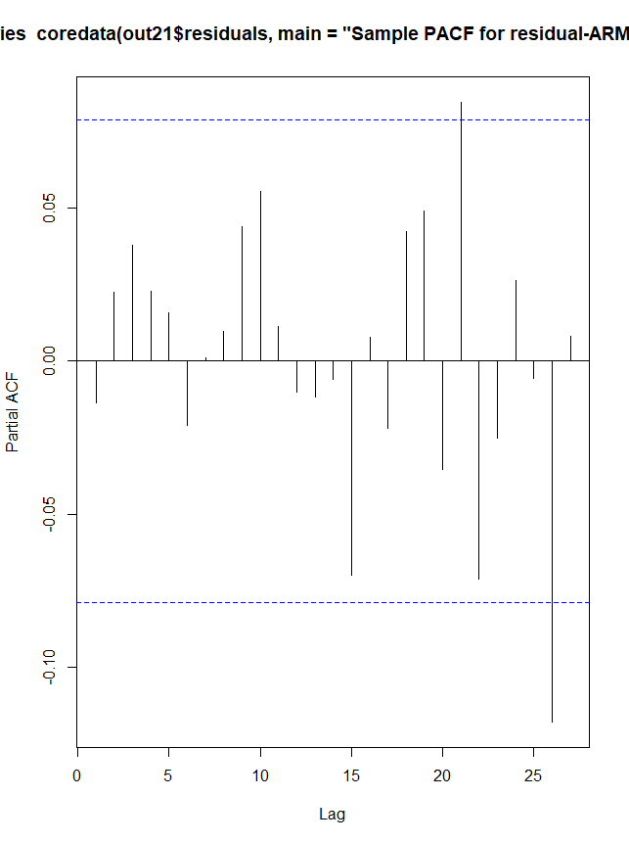
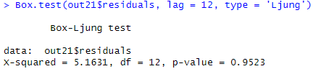
Residual Analysis

Slide 16
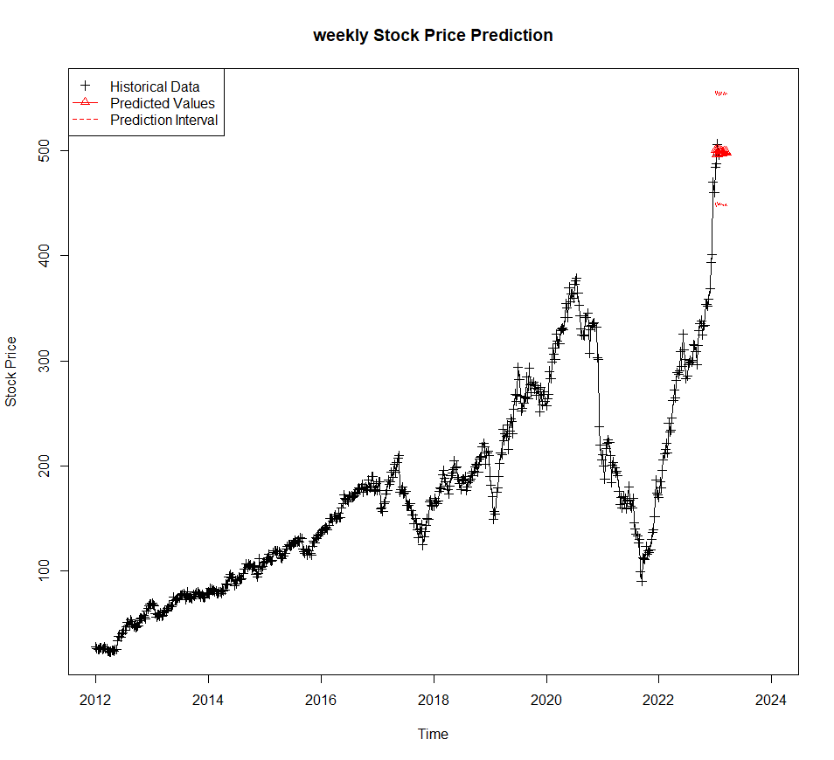
Weekly Stock Price Prediction

Slide 17
Conclusion
Reasons for Predicting:
1. It provides insights into potential future trends
2. Serves as an indicator of broader economic trends and corporate health.
3. Facilitates academic and professional research into financial markets, enhancing understanding of market behaviors and patterns.
4. Provides data for building automated trading algorithms to capitalize on short-term market inefficiencies.
5. Enables the identification of potential market risks and the development of strategies to mitigate losses.

Slide 18
Resources
Links:
https://www.marketbeat.com/stocks/NASDAQ/META/chart/
https://www.tradingview.com/symbols/NASDAQ-META/
https://www.barchart.com/stocks/quotes/META/price-history/historical
https://247wallst.com/technology-3/2024/11/29/meta-platforms-meta-price-prediction-and-forecast-2025-2030/
https://www.investors.com/news/sp-500-magnificent-seven-stocks-market-cap-loss/

Slide 19
THANK YOU!!

